Slide 1

DragonBall
10-28-2019
Notes:
Hello everyone, my name is James, and we are team dragonball.
So We are team seven, and we have seven teammates, since we know in the anime dragon ball, if you have seven Dragon balls, you can summon the shenran and make one of your dreams come true, we named our team DragonBall.

Slide 2

Group Members
Jiangguo Zhang (team lead)
Yifan Wang (tech lead)
Sibo Wang (doc lead)
Shunda Huang (dev)
Can Sun (dev)
Enze Zhong (dev)
Tingting Zhou (dev)
Notes:
These are my wonderful teammates, they have done a great job in this project. It’s my honor to work with them.

Slide 3





Contents
Game overview
Use cases
UML, Interface and Abstract Class
Next Step
Notes:
In this presentation, we have four topics to discuss, First we are gonna talk about the Game Overview and Use cases. Then we will give you a more in depth introduction about our UML, Interface and abstract class. Finally in the next step section, we will talk a little bit about our future plan. Ken and I will introduce the Game Overview section to you guys, and the rest of my team will introduce the remaining sections.

Slide 4

Design Inspiration
A map contains a dragon and a ball
Notes:
Our design of the game is inspired by the DragonBall, therefore, our map contains a dragon and a ball.

Slide 5
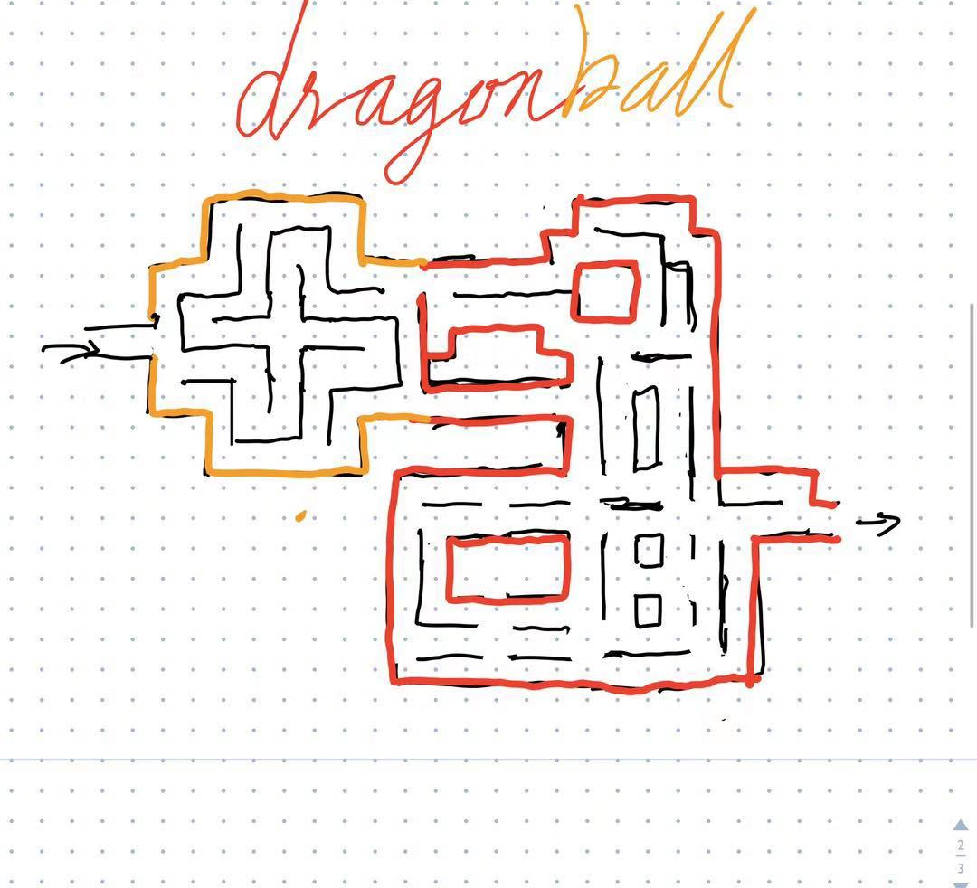
Initial
Sketch
Notes:
This is the sketch of our game map, as you can tell, the part on the left looks like a ball, and the part on the right looks like a dragon.

Slide 6




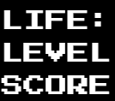

Items
Wall
Pacman
Ghost
Pac Dots
Info Board
Other Features
Notes:
Thank you James.
There are 6 elements in our game. Wall, there are 3 kinds of wall in our game, if a wall is colored blue, orange or red, then it’s a regular wall, a wall that only Ghost can pass is green and a white transportation wall.
Pacman, our main character.
Ghost, with two states, one can be eaten by pacman, another kills the pacman.
Pacdots, which contains regular dots and power dots.
Info board, with life, level, score and highscore in it.
Besides, two buttons are included, a start button to reset the game and a pause button to pause it.

Slide 7
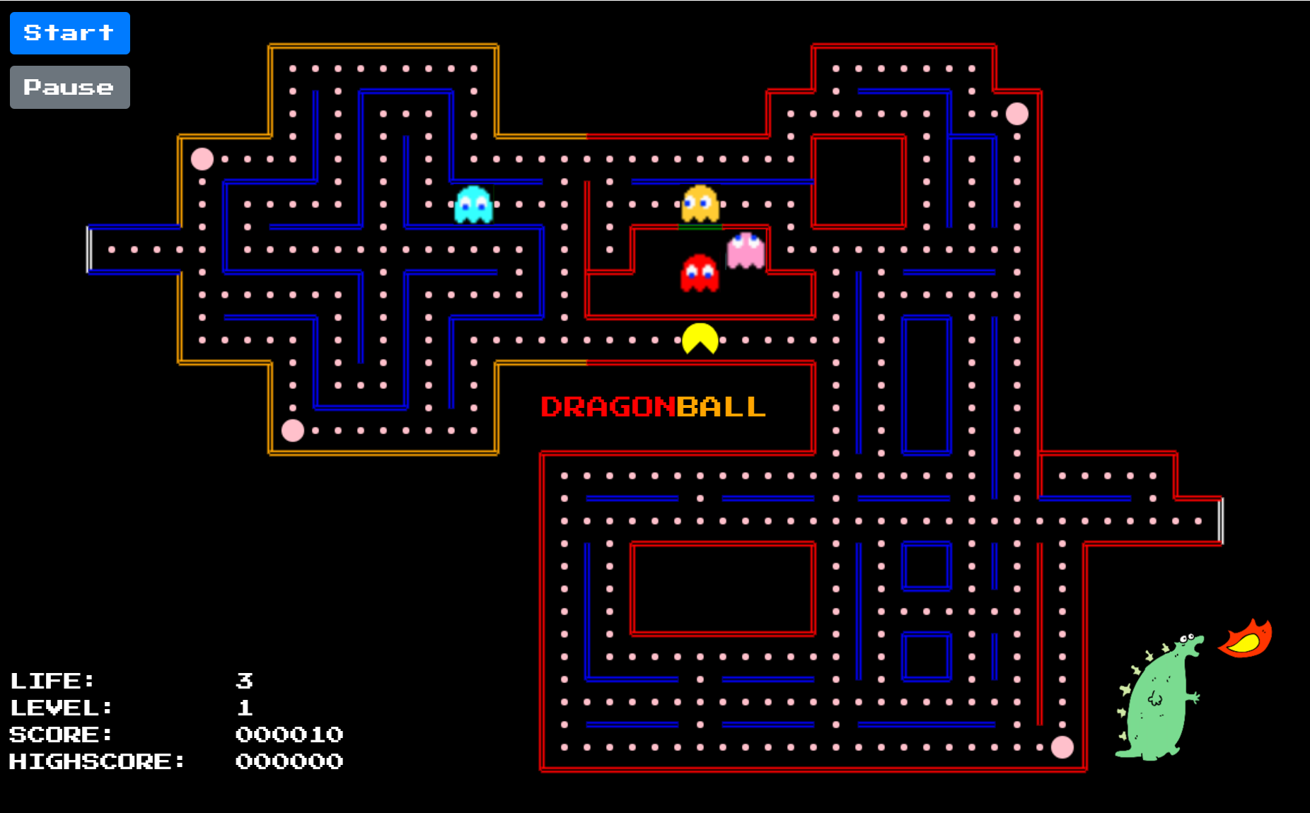
Game Overview
https://pacman-team-dragonball.herokuapp.com/
Notes:
Here is an overview of the game layout. You can tell from this demo that it contains what a basic pac-man game needs, a cute logo and some control buttons.
Ghosts will respawn from the cage above the pacman and enter the world through the green wall.
The pac-man and ghosts are able to transport between the left and right exit.
You guys can try it using the website here, but do not try to move the pacman, cause it will cause problem when there are multiple accesses.
Then eric will introduce the use cases to us.

Slide 8


Use Cases
Pacman
Ghost
Notes:
We have two groups of uses cases for the game. One for Pacman, and the other for ghost.

Slide 9
Pacman
Move straight
Change direction in the next opening, based on the last key pressed.
Notes:
For Pacman, it moves straight along the paths in the map, and will change direction according to the player’s input. The Pacman will only change direction in the next opening.

Slide 10



Pacman
When collides with:
Wall
Stop
Pac dots
Eat
Power dots
Eat and empower
Bonus dots
Eat (more points)
Ghost
Die when normal
Eat when powerful
Notes:
These are the Pacman’s interactions with the objects in the game: If the Pacman hasn’t been given instructions before colliding with a wall, it will stop at the wall, or it will move according to user’s instruction. There are 3 kinds of dots in the game: Pac dots, Power dots and Bonus Dots. The Pacman will eat all three kinds of dots and gain points with a slight difference being that the power dots will vest power in the Pacman thus it can hunt ghosts, and Bonus Dots will give more points to the Pacman. The last scenario is dependent on the status of the Pacman: if the Pacman is empowered, it can eat the ghost, otherwise it will be killed.

Slide 11
Ghost
Normal
Wait until it can leave home
Chase the pacman
Eyes
When pacman eat the ghost
Run back to its home and reset to normal
Notes:
When the game initializes, the ghost will have normal strategy. The ghosts will wait at spawning point and starts chasing the Pacman when the game begins. Another use case is when the ghost is eaten by the Pacman, the ghost will transform into eyes and travel back home.

Slide 12
Ghost
Dark blue
Slow down
Color: dark blue
Escape from the pacman
Eaten when encounters pacman
Flashing
Slow down
Color: blue and white
Escape from the pacman
Eaten when encounters pacman
Notes:
The ghost will turn to dark blue color when the Pacman eats a Power dot. It will try to escape from the Pacman with a decreased velocity, and will be eaten if a pacman catches it. If the ghost hasn’t been hunted by the Pacman after a while, the ghost will flash for a few seconds and start hunting the Pacman again. Next, I’ll let Yifan take over the stage.

Slide 13
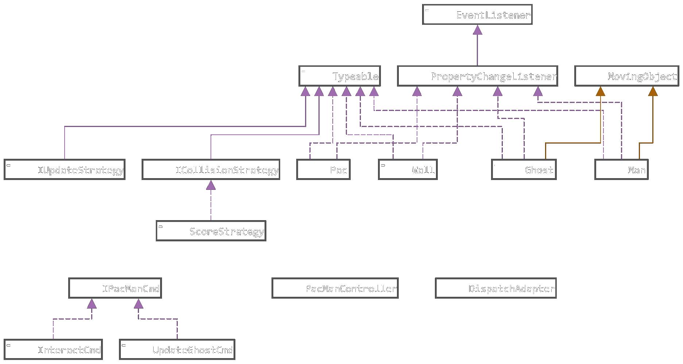
UML Diagram
Notes:
This is our UML Diagram. Our game is totally object oriented, we treat every element on the map as an object. There are pac, wall, and ghost and pacman. Also there are strategies and commands to help update the status of our models. We encapsulate the object moving behavior to the MovingObject class, it will make managing the movement of ghosts and pacman much easier.

Slide 14
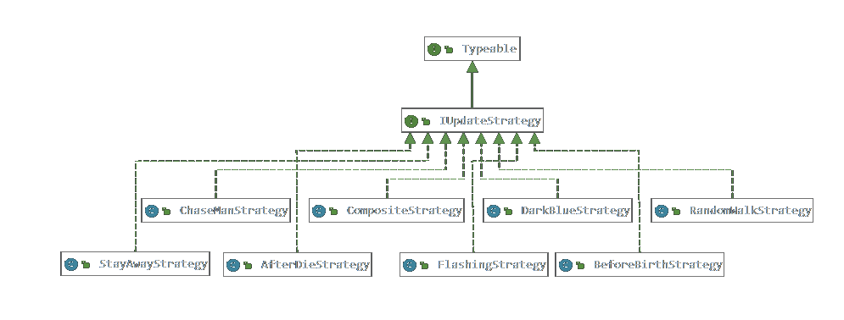
UML Diagram
Notes:
Considering the ghosts moving strategies, we use the IUpdateStrategy interface to represent the status of ghosts.

Slide 15
Interface and Abstract Class
Interface:
Typeable
ICollisionStrategy
IUpdateStrategy
IPacManCmd
Abstract Class:
MovingObject
Notes:
These are our interfaces and abstract class, I will explain them a little bit more in the following slides.

Slide 16
Typeable
Get the type of the object
Ghost
Man
Pac
Wall
Strategies
Notes:
Typeable interface is basically implemented by most of the classes, it’s used to represent the model’s type, for example, the ghosts’ strategies should have different types.

Slide 17
ICollisionStrategy
ScoreStrategy
KillManStrategy
…
Notes:
ICollisionStrategy is used to trigger interaction between objects, for instance, gain scores and kill the man.

Slide 18
IUpdateStrategy
AfterDieStrategy
BeforeBirthStrategy
ChaseManStrategy
CompositeStrategy
DarkBlueStrategy
FlashingStrategy
RandomWalkStrategy
StayAwayStrategy
Notes:
IUpdateStrategy will determine how the ghosts will move, and represent the ghosts’ status.

Slide 19
IPacManCmd
InteractCmd
UpdateGhostCmd
...
Notes:
Commands are simply used to perform updates on objects.

Slide 20
MovingObject
Manages all the moving information
Location
Velocity
Direction
Radius
Strategy
Extended by moving class
Ghost
Man
Notes:
MovingObject class makes moving ghosts and man very simple, it hides all the detail of moving, which will make development much easier.
So here’s the general design of our models, and then my teammate Tingting will introduce our next step.

Slide 21


Next Step
Implement the game
Polish the game
Ghost strategy
Statistical board
Level design
Point design
Background music

Slide 22


Thank you!
Any questions?

